Slide 1
Employee Data Analysis using Excel
STUDENT NAME: ARJUN C
REGISTER NO: 2213211036002/unm13212213211036002
DEPARTMENT: BACHELOR OF COMMERCE(GENERAL)
COLLEGE: PRESIDENCY COLLEGE(AUTONOMOUS), CHENNAI

Slide 2
PROJECT TITLE
Employee Salary Analysis
Using Excel

Slide 3


AGENDA
Problem Statement
Project Overview
End Users
Our Solution and Proposition
Dataset Description
Modelling Approach
Results and Discussion
Conclusion
3/21/2024 Annual Review

Slide 4

PROBLEM STATEMENT
Examine the salary distribution across different departments in different companies to identify disparities.
Analyse how each department contributes to the overall payroll across different companies, identifying potential imbalances and optimization opportunities.

Slide 5

PROJECT OVERVIEW
The Employee Salary Analysis project aims to analyse the salary structures across three companies to evaluate fairness, competitiveness, and alignment with industry standards.
This analysis will examine salary data across various departments and roles, identifying any disparities and key factors that influence compensation, such as experience, tenure, and employment type.
The project will generate actionable insights and recommendations for improving salary practices, ensuring equity across the companies, and supporting effective talent retention and recruitment strategies.
The findings will contribute to optimizing compensation strategies, enhancing employee satisfaction, and ultimately supporting the organization’s long-term growth and talent management objectives.

Slide 6

WHO ARE THE END USERS?
USERS | PURPOSE
Chief Human Resources Officer | Ensure competitive, fair, and equitable salaries across the organization
Chief Financial Officer | Evaluate the financial impact of salary structures and optimize payroll allocation
Department Heads | Guide decisions on promotions & salary adjustments within their departments
Talent Acquisition Manager | Create competitive salary offers that align with the company’s compensation strategy
Diversity and Inclusion Officer | Ensure that compensation practices are equitable across all demographics

Slide 7

OUR SOLUTION AND ITS VALUE PROPOSITION
TECHNIQUES USED IN THE ANALYSIS:
FILTER – To divide the data
PIVOT TABLE – To summarise the data
FORMULA – To calculate the percentage
GRAPH – To visualize the data
Our project offers strategic solutions to optimize salary structures across three companies by identifying disparities and recommending adjustments. These solutions aim to ensure fair, competitive, and equitable compensation, enhancing employee satisfaction and retention while aligning with organizational goals. The value proposition is in fostering a motivated workforce and supporting the companie’s competitive positioning in the market.

Slide 8
Dataset Description
Content: Employee salary data from three companies, covering multiple departments and roles. Key Variables: Company Name: Identifies the company for each employee. Department & Role: Specifies the department and job role. Salary & Bonus: Includes base annual salary and any additional bonuses. Employee Demographics: Age, years of experience, and tenure with the company. Employment Type: Differentiates between full-time, part-time, and contractor roles.

Slide 9
Dataset Description
Granularity: Detailed data at the individual employee level for in-depth analysis. Potential Uses: Salary Comparisons: Across departments and companies. Equity Assessment: Identifying salary disparities based on demographics. Strategic Planning: Informing compensation strategies and payroll budgeting.

Slide 10
THE "WOW" IN OUR SOLUTION
Comprehensive Comparative Analysis: The ability to compare salary distributions not just within a single company, but across three different companies, allowing for a robust benchmarking of compensation practices. Departmental and Role-Based Insights: The data enables a granular analysis of salaries by specific departments and job roles, providing a clear picture of how compensation varies within different parts of an organization. Demographic and Tenure Impact: The dataset includes demographic details like age, experience, and tenure, which allows for the exploration of how these factors influence salary and bonus allocations, potentially revealing trends related to pay equity or biases. Employment Type Analysis: With information on full-time, part-time, and contractor roles, the dataset allows for an examination of how different employment types are compensated, offering insights that can guide flexible workforce strategies.
3/21/2024 Annual Review
10

Slide 11
MODELLING
DATA PREPARATION
Clean and standardize data (remove duplicates, handle missing values, format consistency).
DESCRIPTIVE STATISTICS
Calculate the mean, median, range, and standard deviation for salaries. Use frequency distributions for salary ranges and departmental data.
CATEGORICAL ANALYSIS
Use pivot tables to summarize salaries by department, gender, and job title. Cross-tabulate variables to explore relationships (e.g., gender vs. salary).
TREND AND PREDICTIVE ANALYSIS
Conduct time series analysis for salary trends.
Develop predictive models to forecast future salary trends.
CLUSTERING
Apply clustering techniques to identify employee groups with similar characteristics (e.g., high earners, potential leavers).
BENCH MARKING
Compare internal salary data with industry benchmarks to evaluate competitiveness.
11

Slide 12
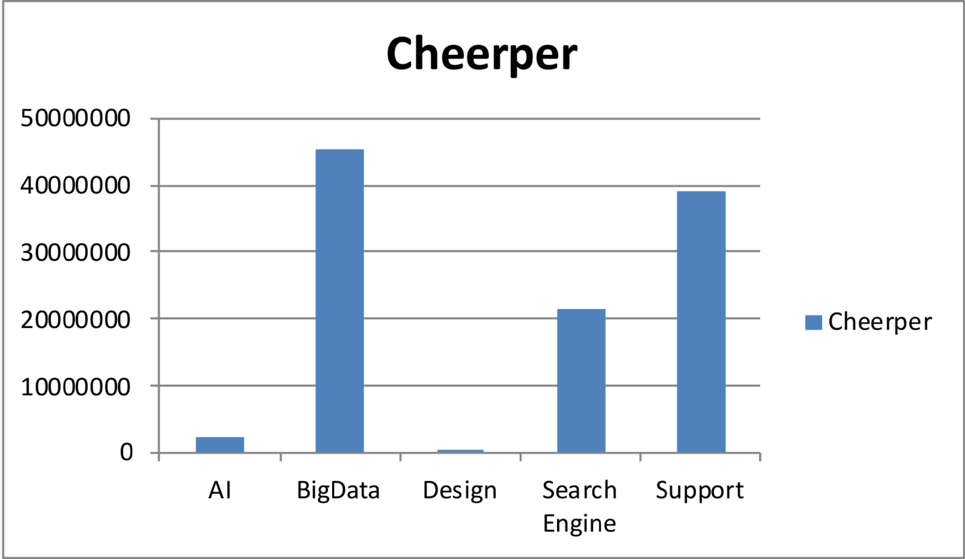
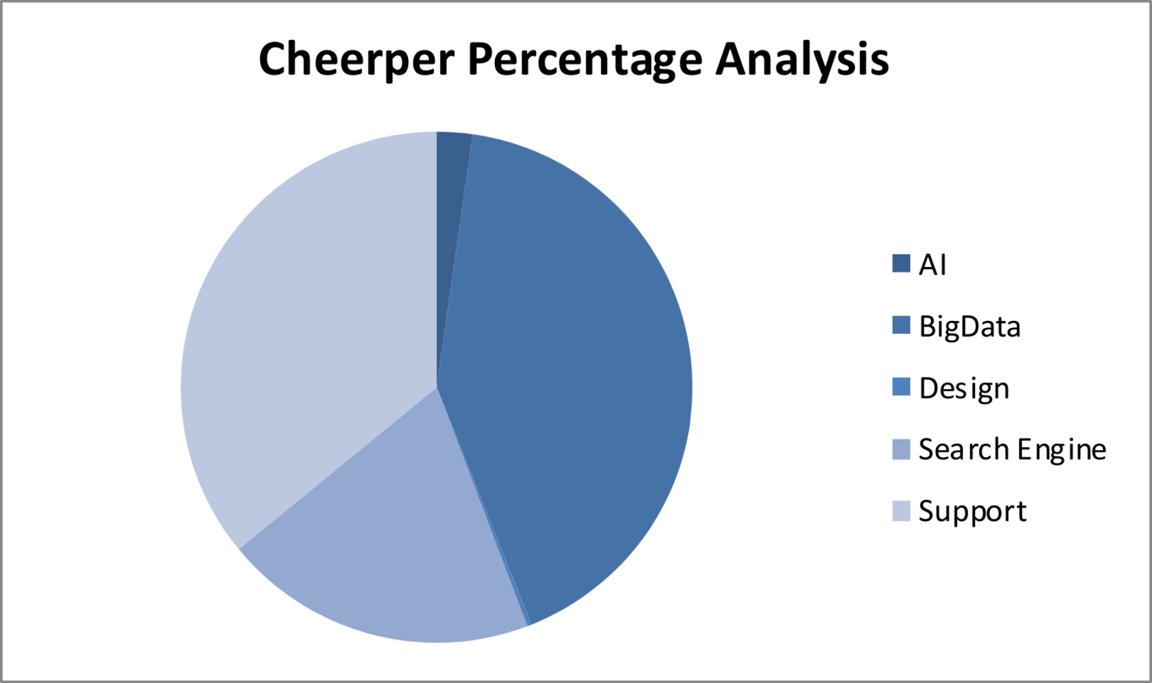
RESULTS
12

Slide 13
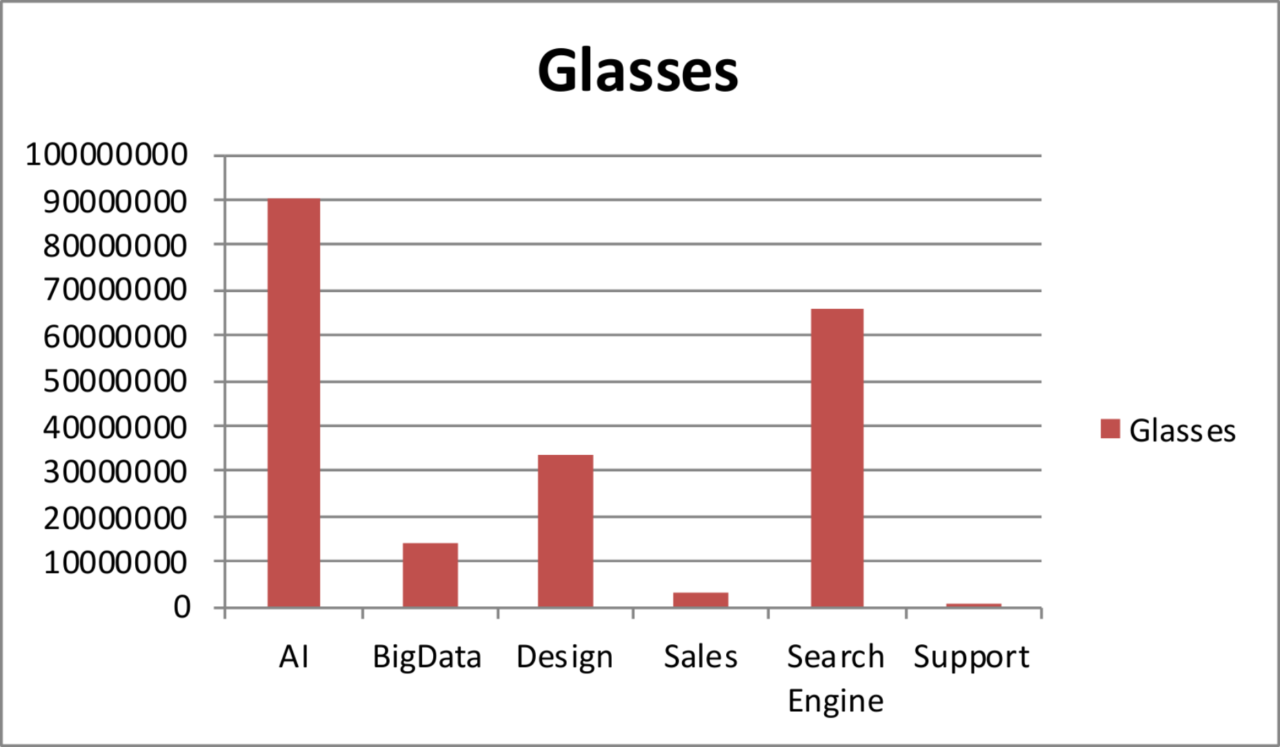
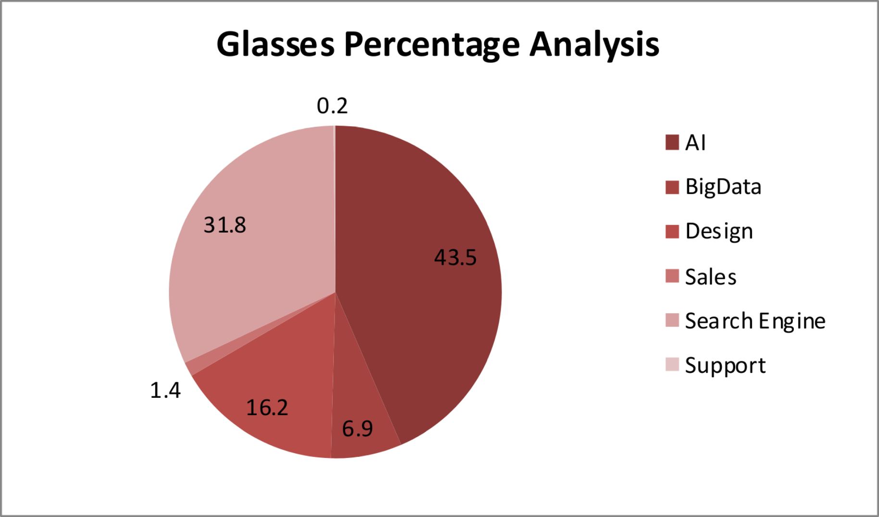
RESULTS

Slide 14
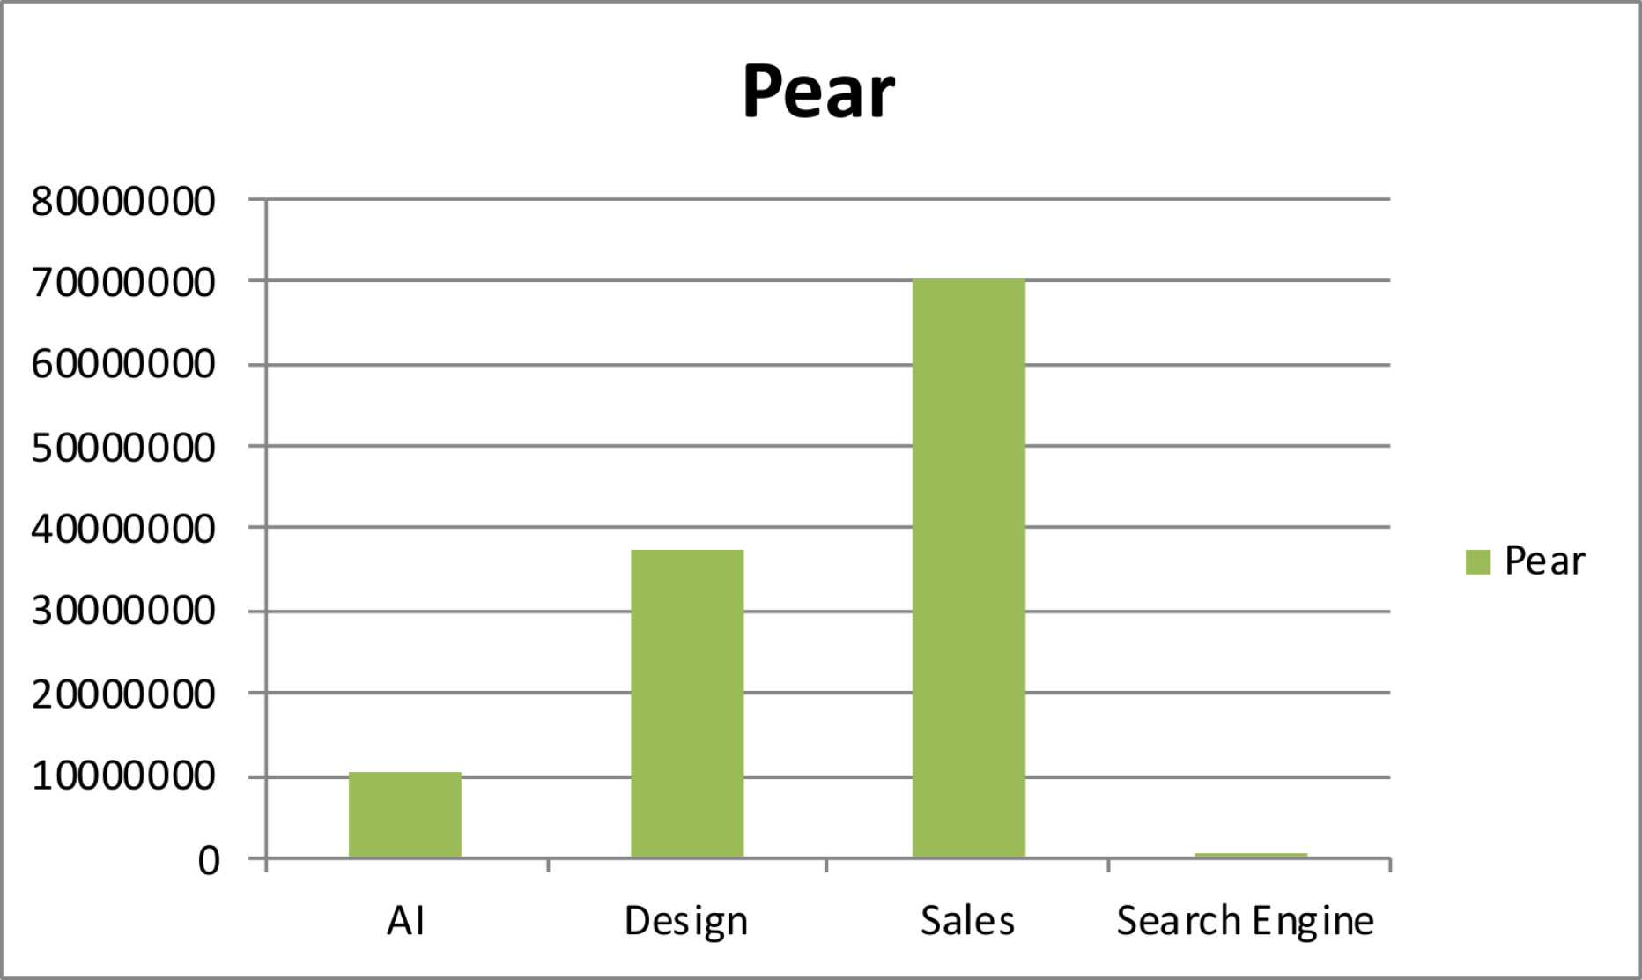
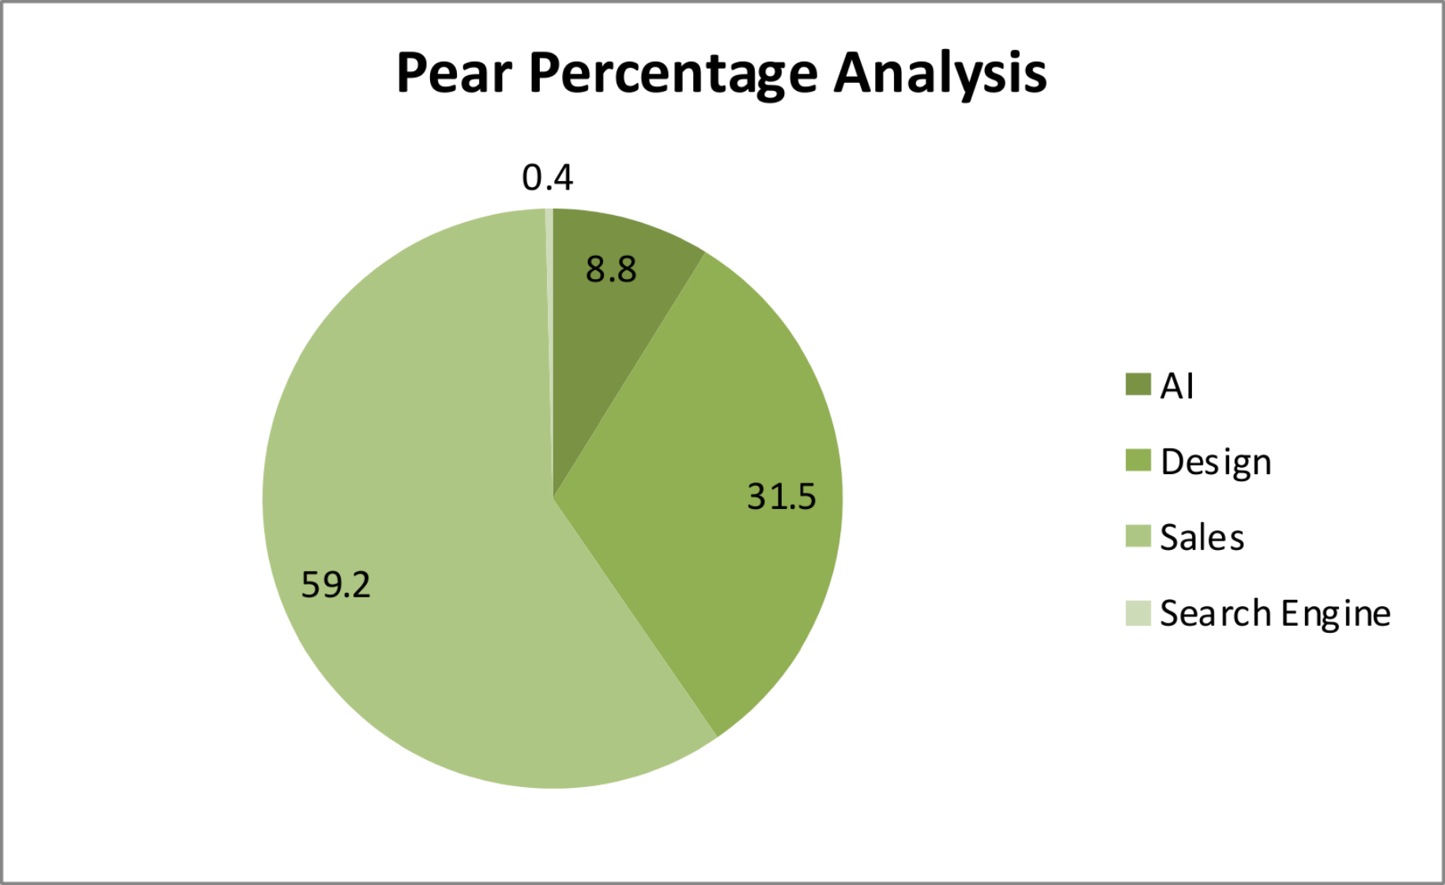
RESULTS

Slide 15
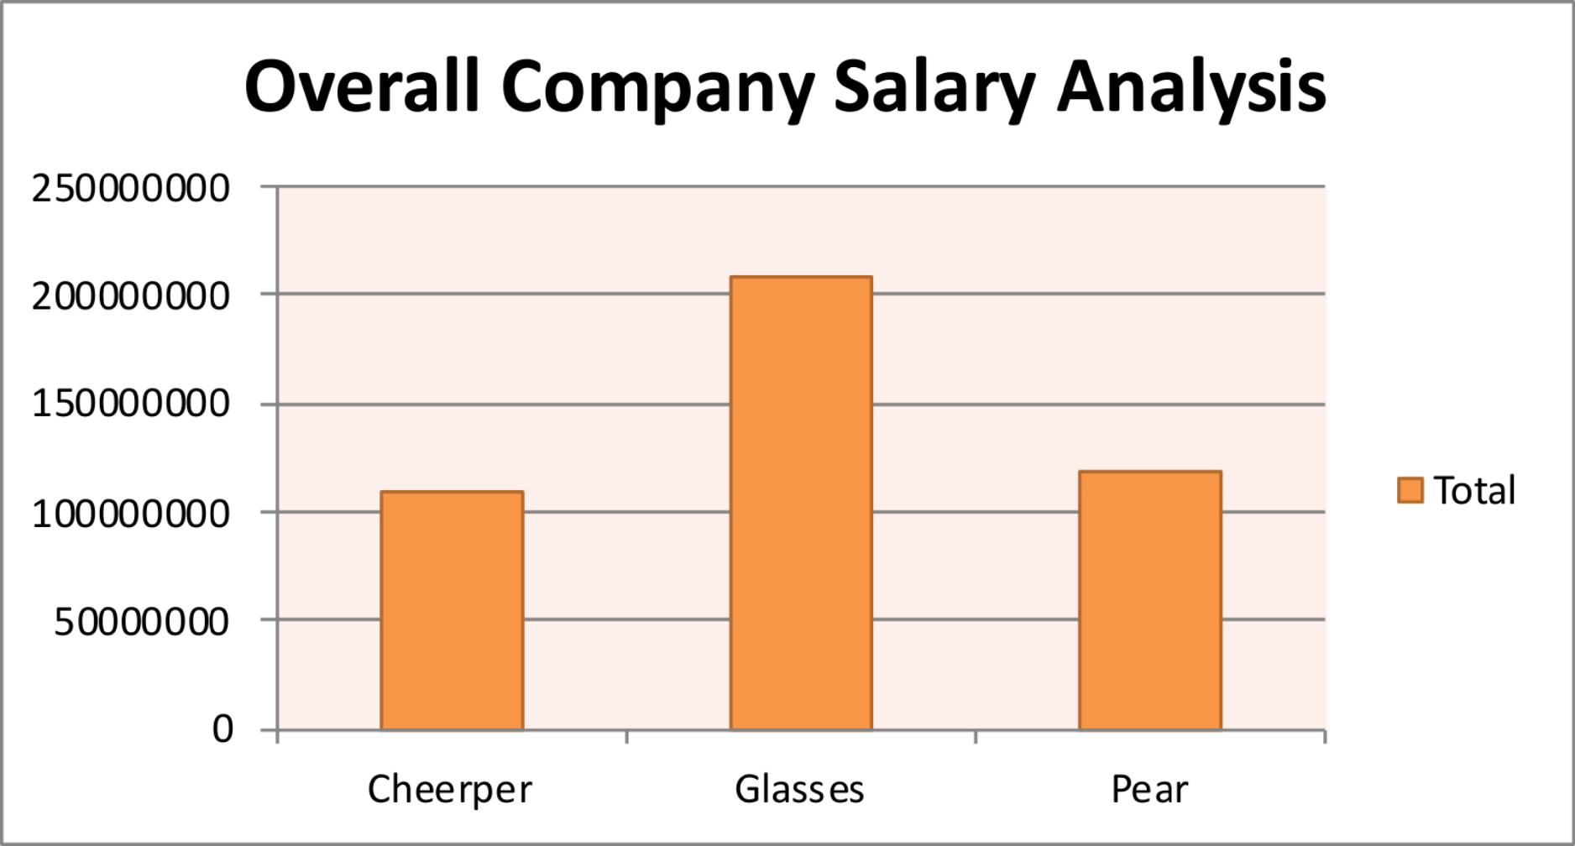
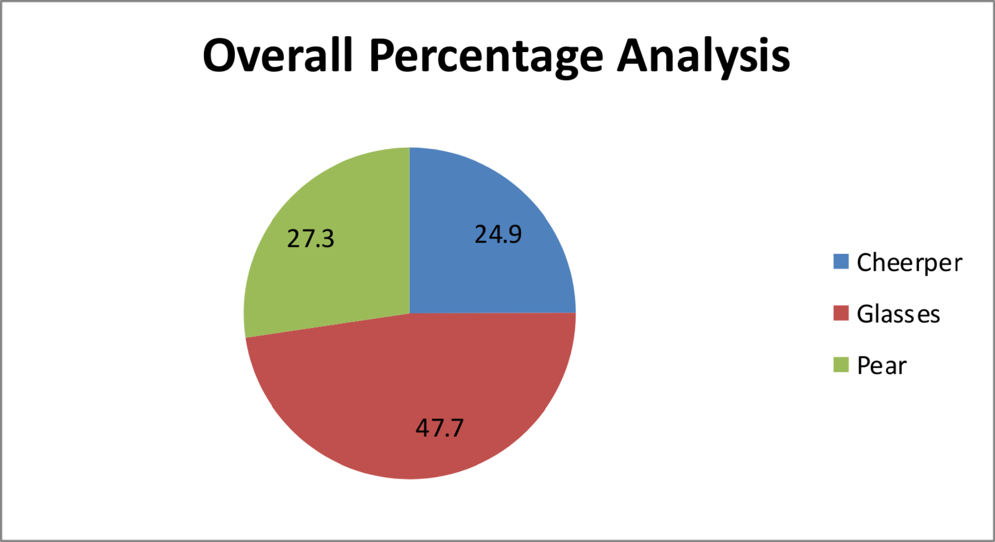
RESULTS

Slide 16
Conclusion
Salary Distribution:
The analysis highlights considerable variations in salaries across departments, with Engineering and AI showing the highest average salaries. This indicates either a higher concentration of senior roles or a strategic investment in these departments, which are likely critical to the company's core functions and innovation efforts.
Departmental Salary Disparities:
The analysis shows significant salary differences across departments, with Engineering and AI receiving the highest pay. This highlights the importance of these departments but also suggests a need to review salary distribution for greater equity.
Experience-Linked Pay:
While experience generally leads to higher salaries, the connection between tenure and pay varies across departments like Design and BigData. Standardizing how experience is rewarded could improve consistency and fairness in compensation.

